Slide 1


CAPSTONE PROJECT
PROJECT TITLE
Presented By
Student Name: Vedant Vinod Rakshe
College Name: B.K. birla College
Department: BSc. Sy.ds
Email ID: vedantrakshe95@gmail.com

Slide 2
OUTLINE:
Problem Statement
Proposed System/Solution
System Development Approach
Data Modelling & Deployment
Result
Conclusion
Future Scope
References

Slide 3
Problem Statement:
Context: The video game industry generates billions of dollars globally, but consumer preferences shift drastically across different regions and eras.
The Problem: Raw, historical sales data spanning multiple decades is dense and difficult to parse. Stakeholders and publishers struggle to extract actionable insights regarding market trends, regional cultural divides, and publisher efficiency without a centralized, interactive analytical tool.

Slide 4
Proposed Solution:
The Proposed System: The development of a dynamic, industry-ready Business Intelligence dashboard designed to translate 16,500+ raw game records into strategic visual insights.
Data Collection: Sourced a comprehensive dataset (vgsales.csv) detailing historical global game sales, categorized by platform, year, genre, publisher, and region (NA, EU, JP, Other).
Data Preprocessing: * Cleaned the dataset using Power Query to handle missing values (e.g., null release years).
Standardized data types to ensure accurate time-series and geographical aggregations.
Feature Engineering: Created advanced calculated columns using DAX (Data Analysis Expressions) to categorize games into distinct performance tiers (e.g., "Blockbuster," "Mega Hit," "Standard Hit").

Slide 5
System Approach:
Core Tool: Microsoft Power BI Desktop
Data Transformation: Power Query Editor
Analytical Language: DAX (Data Analysis Expressions) for custom measures and aggregations.
UI/UX Design: Implemented interactive slicers, page navigation buttons, and a dark-themed visual hierarchy to simulate an application-like user experience.

Slide 6
DATA MODELING & DEPLOYMENT:
Data Modeling: Built a robust analytical model that calculates precise metrics on the fly, such as dynamic market share percentages and revenue-per-release efficiency.
Analytical Techniques Applied:
Pareto Analysis: Visualized the 80/20 rule, proving a small percentage of titles drive the majority of industry revenue.
Cohort/Regional Analysis: Segmented consumer tastes by geography to highlight cultural divergences (e.g., Japan's preference for Role-Playing vs. North America's preference for Shooters).
Deployment: The dashboard is finalized in Power BI .pbix format, ready to be published to the Power BI Service workspace for stakeholder access and interaction.

Slide 7
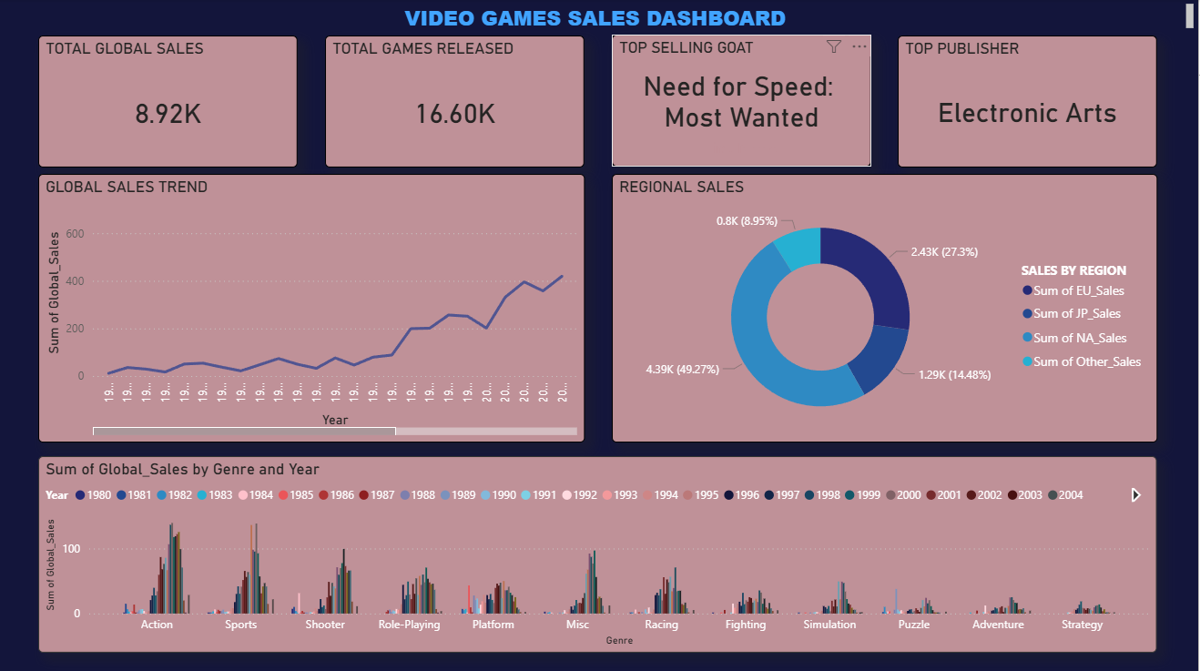
RESULT:
Executive Summary: Highlights global revenue trends and top performers.

Slide 8
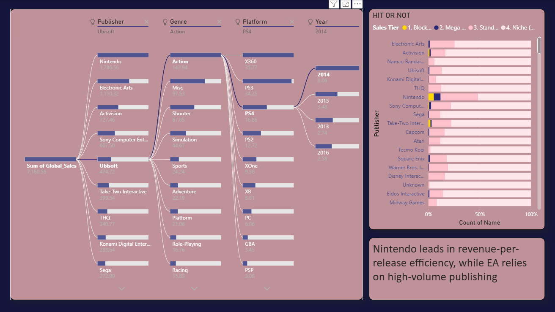
RESULT:
Publisher Analysis: Showcases a custom scatter plot detailing "Volume vs. Quality" strategies among top publishers.

Slide 9
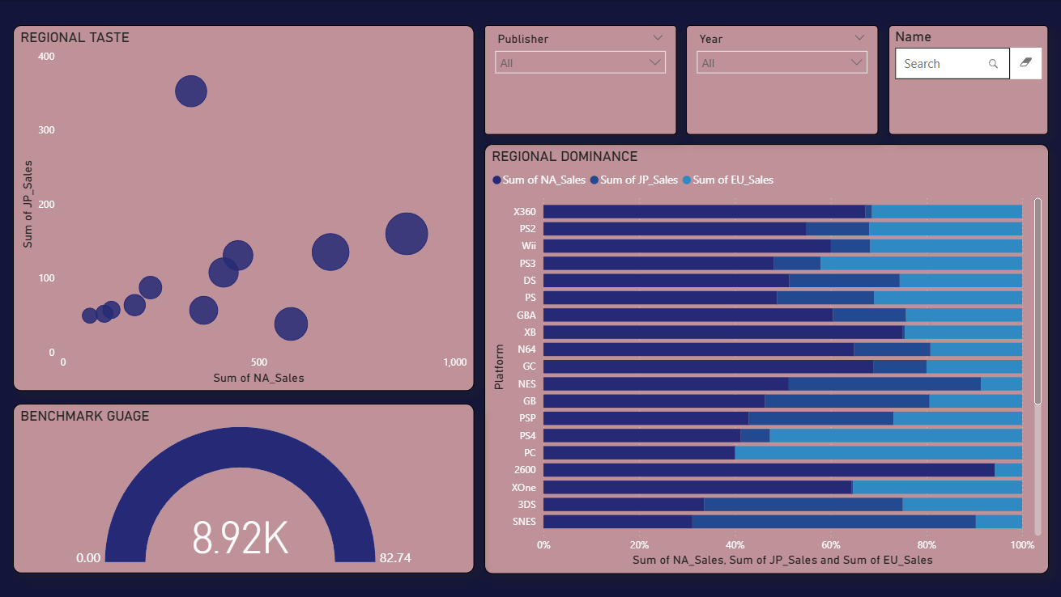
RESULT:
Regional Cultural Divide: Maps out genre preferences segmented by global markets.

Slide 10
Conclusion:
The interactive Power BI dashboard successfully transforms dense, historical sales data into an accessible decision-support system.
By leveraging data visualization, the project clearly identifies major shifts in the gaming landscape, allowing stakeholders to easily navigate decades of data to understand what hardware and genres drive global revenue.

Slide 11
Future scope:
Predictive Analytics Integration: Incorporate machine learning models (like Random Forest or XGBoost) directly into Power BI to forecast the potential first-year sales of unreleased games based on their genre and publisher.
Live Data Connections: Connect the dashboard to live APIs (such as the IGDB or Twitch API) to overlay current player engagement and streaming viewership metrics on top of historical sales data.

Slide 12
REFERENCES:
Microsoft. (2024). Power BI documentation. Microsoft Learn. https://learn.microsoft.com/en-us/power-bi/
Microsoft. (2024). Data Analysis Expressions (DAX) Reference. Microsoft Learn. https://learn.microsoft.com/en-us/dax/
Microsoft. (2024). Power Query documentation. Microsoft Learn. https://learn.microsoft.com/en-us/power-query/
Gregorut. Video Game Sales Dataset. Kaggle. https://www.kaggle.com/datasets/gregorut/videogamesales
GitHub Link: https://github.com/VR-95/MICROSOFT-POWER-BI-DASHBOARD

Slide 13
Thank You

